Slide 1

The “good” the “bad” and the “ugly”
Phase Holdover Performance of Super High Performance Quartz Oscillators Versus Rubidium Atomic Clocks
Nir Laufer , Senior Director PLM , Oscilloquartz
ITSF Nov 2018

Slide 2
Distributed Architecture Using GM in Aggregation
GNSS
GM
T-SC
GNSS
T-SC
T-GM
PTP
Grandmaster
First Aggregation Node
T-SC
Packet-Based Core Network (PTP unaware)
Phase Delivery From Aggregation sites

Slide 3


What are the implications of GM in aggregation site?
  Challenging environment
    Power , Size and cost optimisation
    Good network management system
    Wider temperature variations
    Protection in case of failure

Slide 4

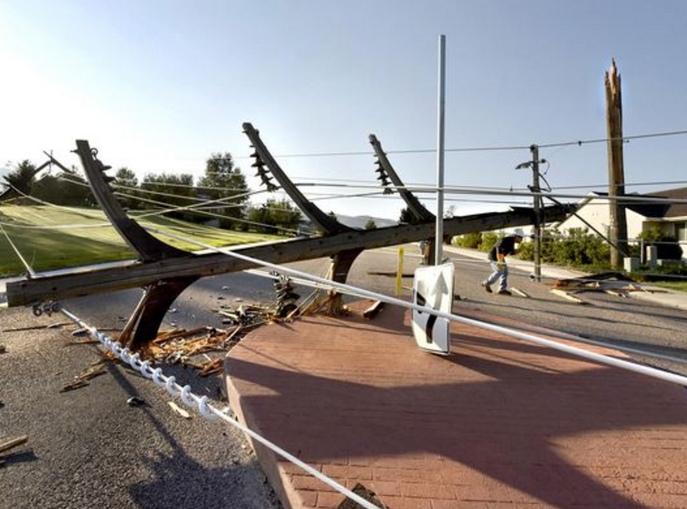
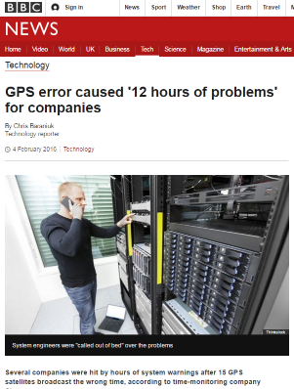
It can get ugly…
GNSS failure
  Jamming
  Antenna breakdown (lightning , cable cut)
Equipment failure
  HW failure

Slide 5

Protection and Redundancy Options:
GM switching to secondary source in case the primary source fails.
  Secondary source - PTP Input , Sync-E, BITS
  Might prevent network rearrangement if secondary source sufficiently good
  But … secondary source not always available
  In case a secondary source is not available – GM will switch to holdover based on internal oscillator
  Always available!

Slide 6

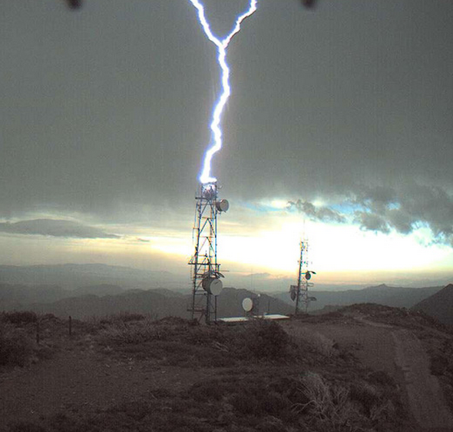
Long Term Holdover
Required in case of long GNSS outage e.g. antenna failure due to lightening
Duration : Few hours – 3 days
Holdover performance depends on oscillator type

Slide 7
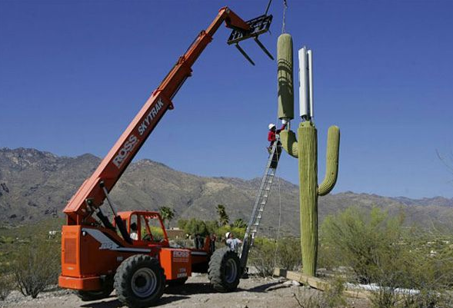
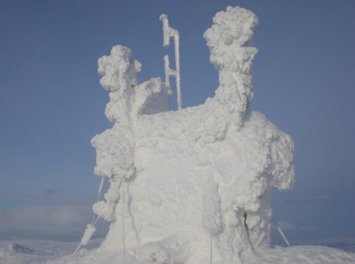
Will temperature be constant during long holdover?

Slide 8
ETSI Temperature Classes
ETSI Temp Class * | Class description | Temp. change range
3.1 | Temp. controlled locations | [+5, +40°C]
3.1E | Temperature-controlled locations, exceptional operating conditions | [-5, +45°C]
3.2 | Partly temperature-controlled locations | [-5, +45°C]
3.6 | Control room locations | [+15, +30°C]
ETSI EN 300 019-1-3 V2.3.2 (2009-11)
Temperature will most likely change during long holdover periods!

Slide 9

What is a Super DOCXO?
Super DOCXO is a new generation of high quality double oven quartz oscillator with internal temperature compensated mechanism
Extremely stable under temperature variations:
Frequency stability Vs temperature: +/- 1e-11 [-20 to 70]
Freerun daily aging : +/-2e-10
Residual daily aging after compensation : +/- 5e-11

Slide 10
Oscillator Types – Aging and Temperature Stability
Temperature Stability
over temp. range
≤10ppb
OCXO
≤1ppb
≤0.1ppb
Rubidium
≤0.01ppb
Super
DOCXO
Super
DOCXO
X2 better Aging Vs Super DOCXO
≤0.001ppb
Aging compensation using GNSS
X7 better Temperature Stability Vs Rb
Aging/Day
≤0.0001ppb
≤0.01ppb
≤0.1ppb
≤0.0001ppb
≤0.001ppb
≤1ppb

Slide 11

Oscillator Types - Who is the “good” and who is the “bad” ?
Clock Type # | Cost | Temperature range | Temp Stability | Aging/Day
OCXO | Low (10%) | -40 to 65 C | 1-10 ppb | 1ppb
Super DOCXO | Medium (100%) | -20 to 70 C | 0.01 ppb | 0.05 ppb
Rubidium | High (300%) | 0 to 70 C | 0.07 ppb | 0.025 ppb
Rb High cost , limited operational temperature and instability under temperature variation make it less suitable in aggregation sites

Slide 12
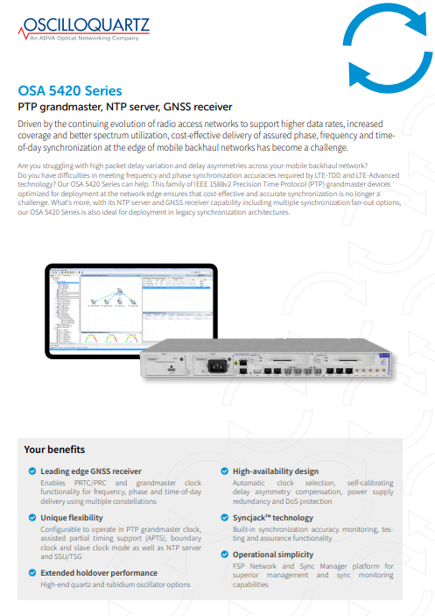
Will the products datasheet help?
Most of the products datasheets specify the holdover performance in contestant temperature but don’t providing holdover specification for variable temperature:
“Holdover values are approximated and assume operation at contestant temperature “
“approximated values assuming constant temperature”
  “ Table lists typical (one sigma confidence) values , Assume a benign temperature environment.”
  What will be the real holdover performance in the field?

Slide 13
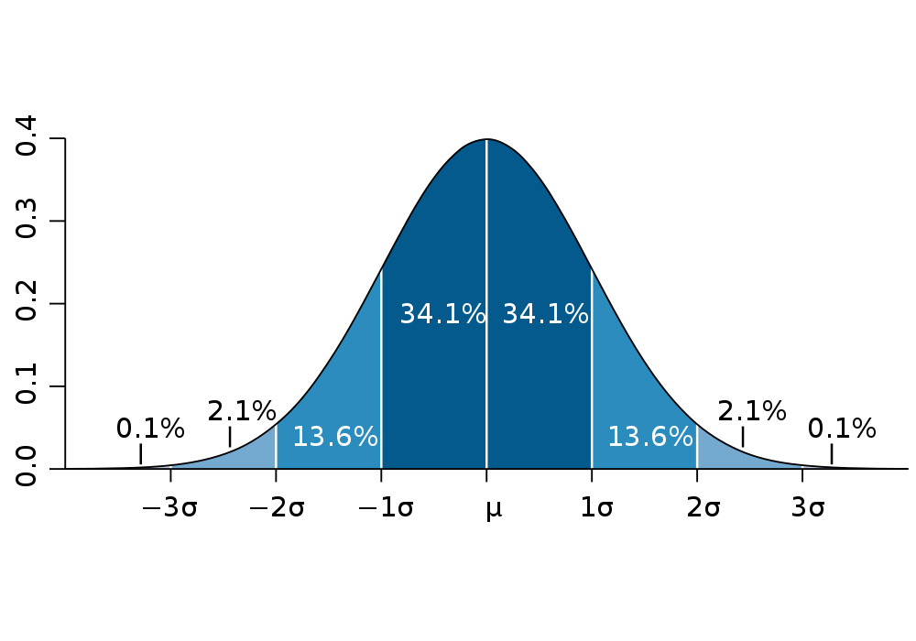
Will the products datasheet help?
In some cases “typical – one sigma confidence” values are used for holdover specification
Which means that in some cases (31.8%) the actual holdover performance might be worst than values provided in the datasheet

Slide 14
What is the optimal solution?
GNSS , while available (prior to holdover) can be used for learning local oscillator characteristics
In order to be able to efficiently learn the oscillator aging the oscillator must have a very good temperature stability
The GNSS long term accuracy is better than 1e-12 (G.8272 require PRTC to be with +/-100 nsec from UTC)
Combining the high temperature stability of the high end oscillator with the GNSS reference can generate optimized solution in both performance and cost

Slide 15
Testing Holdover in Realistic Conditions
The objectives of the test were to measure the real performance of the Super DOCXO Vs Rubidium in lock and in holdover modes
Two PTP grand masters were placed in the same oven under same temperature conditions
Vendor A with Super DOCXO and Vendor B with Rubidium (Rb market leader)
Both devices were connected to the same GPS simulator using a GNSS splitter
Both device were powered at the same time and have been locked to GPS for 72 hours before holdover initiated
The temperature in the oven varied between 25C to 35C

Slide 16
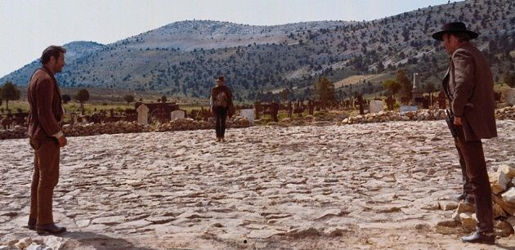
The Duel

Slide 17
Test Setup – The Duel
GPS
Simulator
10MHz
Cs Clock
GNSS RF
GNSS
Splitter
Oven
Rubidium
Super DOCXO
Vendor B
Vendor A
Tester
PPS
PPS
PPS REF

Slide 18
Temperature Profile
The oven was running the following temperature profile during the entire measurement:
  25C for 4 hours
  Ramp from 25C to 35C at 1.5C/min
  35C for 4 hours
  Drop from 35C to 25C at 1.5C/min
  Back to #1
35C
35C
4 Hours
4 Hours
1.5C/Min
1.5C/Min
1.5C/Min
1.5C/Min
…
25C
25C
25C
4 Hours
4 Hours
4 Hours

Slide 19
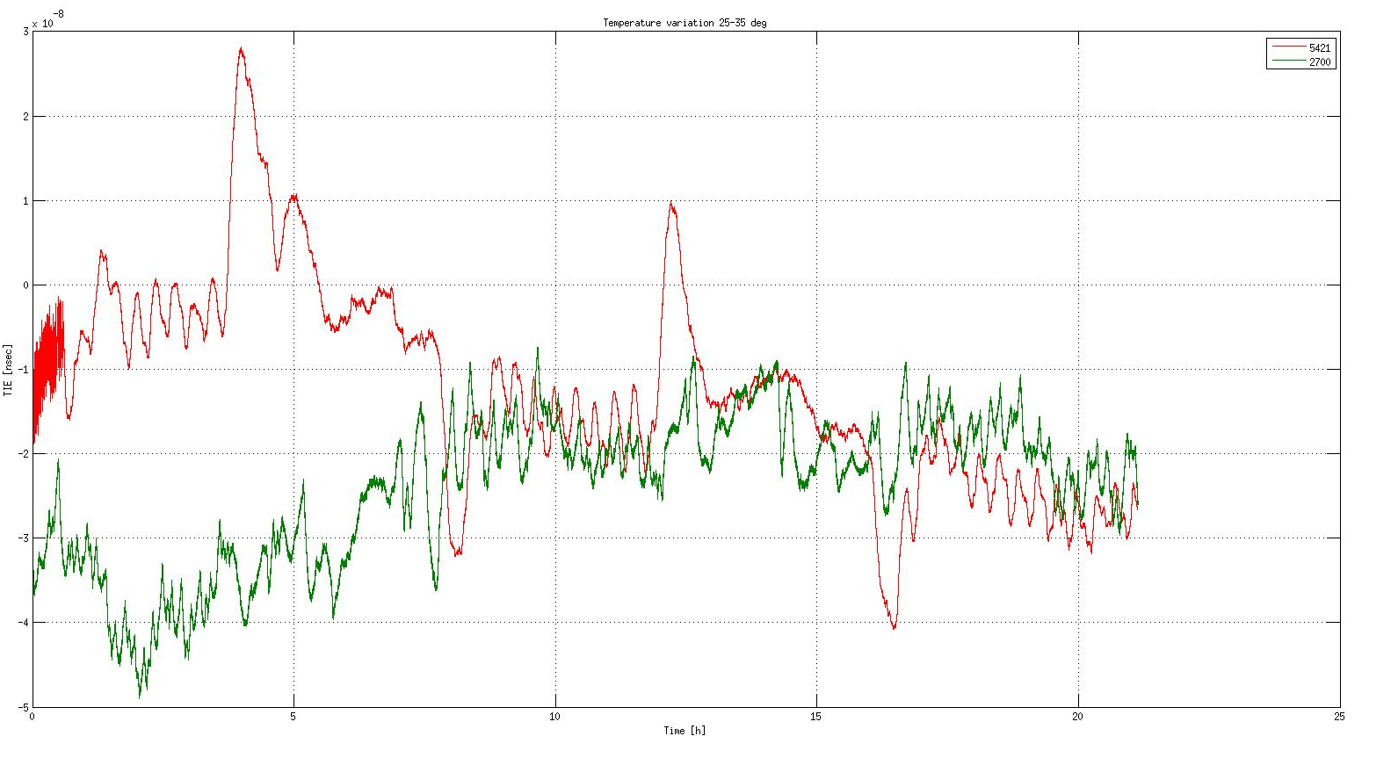
TE Test Results – Locked to GPS (25-35C)
30nsec
Rb output “peaks” during temperature changes
Green – Super DOCXO
Red – Rubidium
Blue – Temperature Profile
Super DOCXO is agnostic to temperature variation
0nsec
TE
30nsec
35C
35C
40nsec
1.5C/Min
1.5C/Min
1.5C/Min
1.5C/Min
25C
25C
1 Days

Slide 20
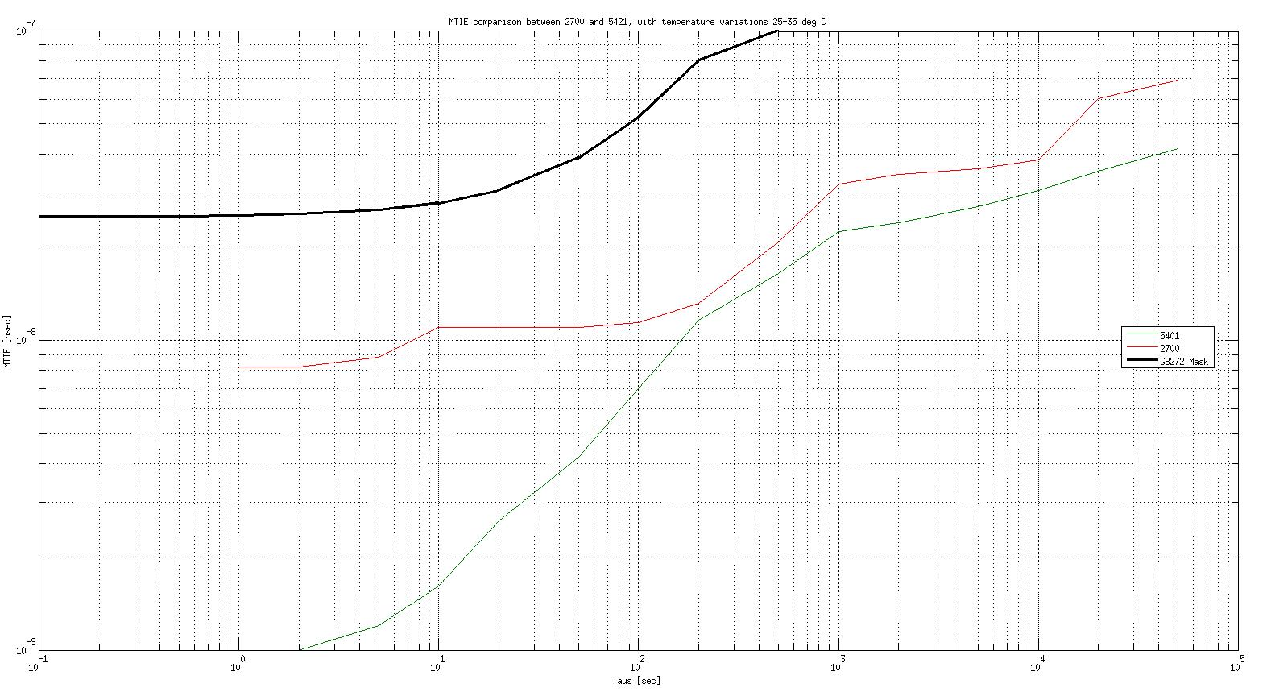
MTIE Test Results – Locked to GPS (25-35C)
Green – Super DOCXO
Red – Rubidium
Black – G.8272 MTIE mask
Super DOCXO with better margins Vs G.8272 MTIE mask

Slide 21
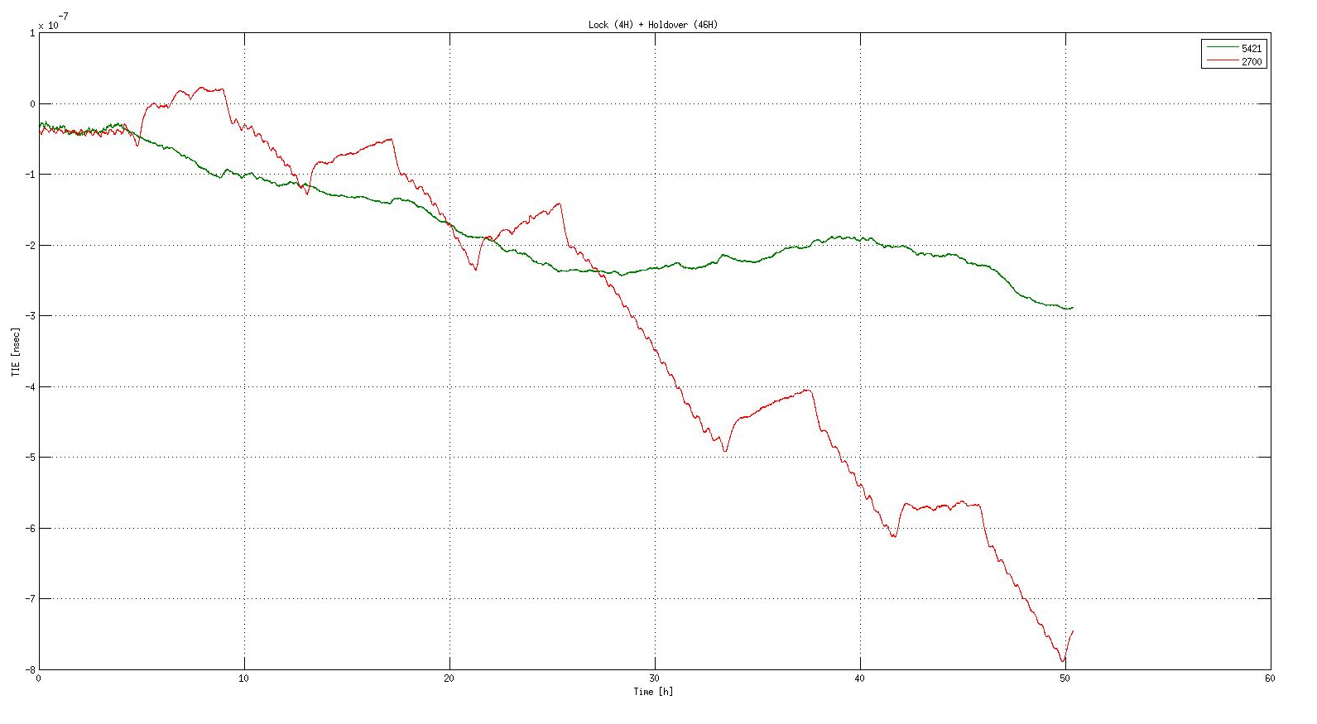


TE Test Results – Holdover (25-35C)
100nsec
Super DOCXO
is agnostic to temperature variation
Green – Super DOCXO
Red – Rubidium
0nsec
300ns
200nsec
GPS
disconnected
TE
800nse
Rubidium “drift” during temperature changes
600nsec
800nsec
2 Days

Slide 22
Worst Case Temperature Profile
Periodic profile is not the worst case profile since error are partly cancelled .
A worst case profile include a ramp at the beginning of the profile followed by constant temperature :
  25C for 4 hours
  Enter holdover
  Ramp from 25C to 35C at 1.5C/min
  Stay 35C for 24 hours
35C
1.5C/Min
24 Hours
25C
…
4 Hours
Disconnect GPS (Start Holdover)

Slide 23
Which oscillator type should be used in ePRTC?
The ePRTC is based on GNSS and Cesium inputs which are connected to clock combiner
The Clock combiner include a local oscillator
Well designed ePRTC is NOT expected to use the clock combiner internal oscillator in holdover
  If GNSS fails – the ePRTC utilize the Cesium for holdover – 70nsec in 14 days!
  If a Cesium fails , the ePRTC can still utilize the GNSS input (and function as PRTC until Cesium is fixed)
ePRTC (G.8272.1)
~
ePRC G.811.1
Local oscillator
Cs clock
GNSS
Combiner
Function of ePRTC
Packet Master Clock

Slide 24
ePRTC internal clock requirements
Reliable (high MTBF)
High temperature stability
Cost
Super DOCXO is the most suitable option!
ePRTC (G.8272.1)
~
ePRC G.811.1
Local oscillator
Cs clock
GNSS
Combiner
Function of ePRTC
Packet Master Clock

Slide 25
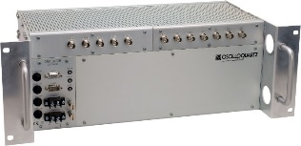

ePRTC Holdover Setup
OSA ePRC Cesium
GNSS
CLK
PPS
Tester (counter)
Lab Ref (NCH)
OSA GM with Super DOCXO (HQ++)

Slide 26
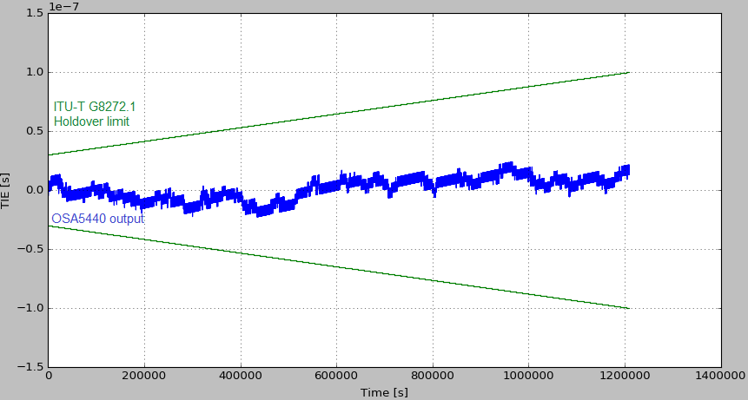
OSA GM with Super DOCXO ePRTC Holdover
100nsec
14 days!
30nsec
0nsec
30nsec
-100nsec
Holdover with Cs
GPS disconnected

Slide 27
Conclusions
The Rubidium clock tested was very sensitive to temperature variations Vs Super DOCXO
The Rubidium clock holdover performance under temperature variations were significantly degraded Vs constant temperature
Actual performance under temperature variation is not listed in the datasheet !
Test your clocks in realistic holdover scenarios which include temperature variation! Testing in constant temperature is not sufficient!
Select the type of oscillator based the expected thermal condition on site
Consider worse case scenarios such as air condition failure or AC hysteresis
ePRTC are using Cesium clocks for holdover and therefore don’t need Rubidium clock in the clock combiner

Slide 28

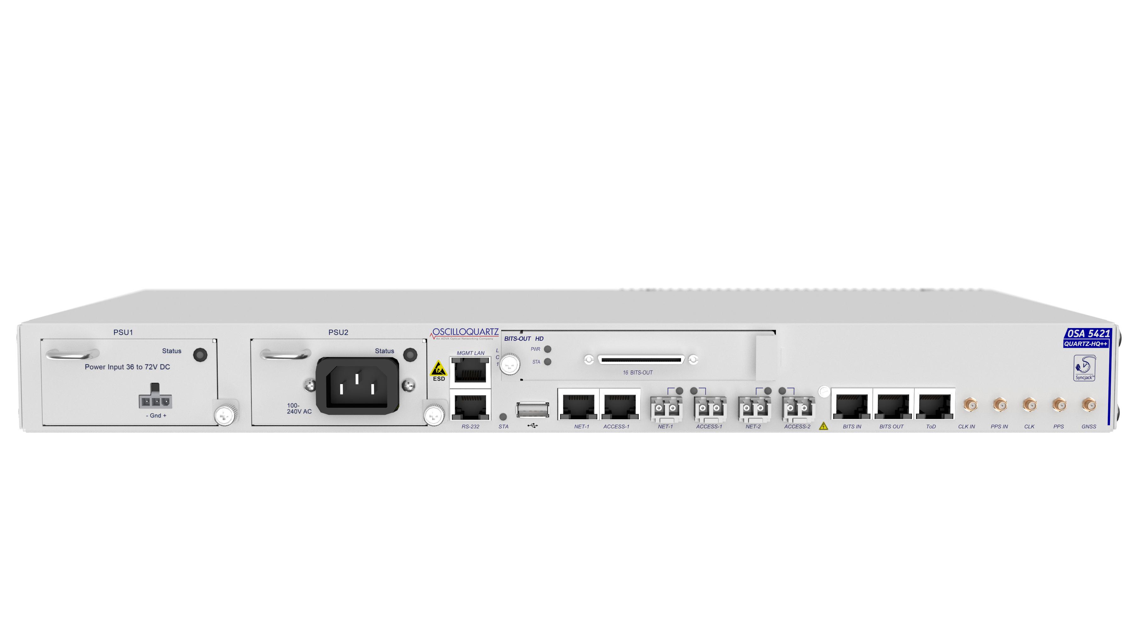
Recommendations
In which cases Rb is recommended ?
  Device is not connected to GNSS (freerunning)
  Cost is not dominant factor
  Temperature is well controlled
In which cases Super DOCXO is recommended ?
  Device is connected to GNSS
  Cost is a dominant factor
  Temperature variation are expected
Test your clocks in realistic holdover scenarios which include temperature variation! Testing in constant temperature is not sufficient!

Slide 29
nlaufer@advaoptical.com

